Slide 1
To Share or Not To Share?
Catherine Naamani
Head of Learning through Technology
@cnaamani
catherine.naamani@southwales.ac.uk

Slide 2
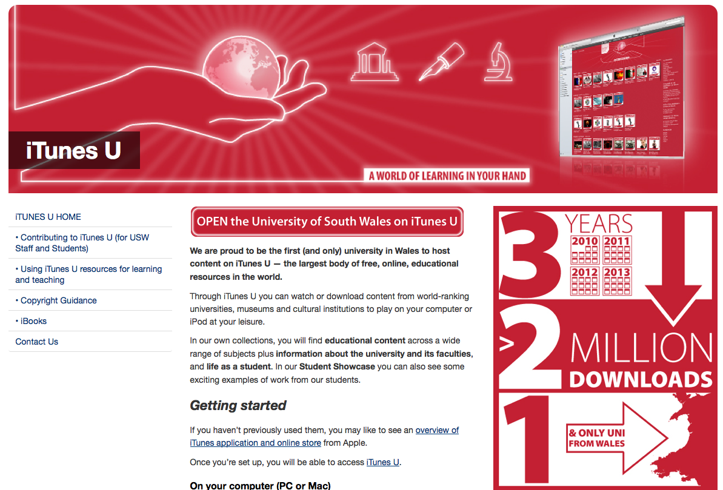
OER at USW

Slide 3
Background
USW formed in April 2013
Variety of tools and systems
2 VLEs (Moodle & Blackboard)

Slide 4
‘Global competition and financial crisis [mean that] radically new approaches to learning are now needed’ Brown & Snower, 2012
‘We can expect these innovations (technology innovation and Open Education) to create a series of new opportunities that will address and improve some of the enduring issues that have faced education—such as access and quality—with the potential to radically alter its ecology and economics’. Kumar, 2012

Slide 5
What online content do you use in your studies?

Slide 6
What online content do you use in your studies?

Slide 7
What staff use…..
Lecture Capture
Video sharing
Own e-learning resources
Social Media

Slide 8
The Student View
‘Easier access to content, Easier sharing of content, Easier searching of content’
‘Give Kindles to all…
‘Upload more content on iTunes U…’
‘Reading list content should be available on Blackboard to read/download…’

Slide 9
Accessing Resources

Slide 10
Accessing Resources

Slide 11
‘The abundance of resources and relationships made easily accessible via the Internet is increasingly challenging us to revisit our roles as educators’ The Horizon Report, in Stephens, 2013

Slide 12
Challenges
‘A mixture of the tools above, but often find clearing with copyright issues takes a very long time and one ends up looking for OER (Open Educational Resources) instead, but these poorly classified or tagged modules can be time consuming to find. Students often find and use their own or shared or purchased apps. Since not all students have access to mobile devices one cannot recommend these for general use in order not to disadvantage some students.’
‘More effective MLE that allowed resources to be re­used and shared more effectively. ‘
‘An easier method of embedding video clips would be useful. Software available on desktop machines for screen recording would be a good way of providing examples in an interactive way.’
‘Greater access to the most current editions of journals. It is almost useless when students can only access free full­text articles online once they 1, 3 or 5 years old.’
‘Making it simple to upload large audio files to Moodle’.
‘More 'User Guides' to help with navigation and e­tasks. Better integration of e­content ­ there is a lot of incompatibility.’

Slide 13
Overcoming Barriers
Training and staff development
Support for students
Digital literacy
Information literacy
Review the interface
Responsiveness
Content management

